Slide 1

Non-Conformance Report (NCR)
A constant drive towards improvement
Madelein Steinberg

Slide 2

Introduction
At Sinvac we strive to continuously improve our processes and procedures to ensure a safe and productive work environment as it’s vital for our growth, resilience, and long-term success. We also aim to always deliver to specifications, and to manufacture products of a high quality. Our service to customers – from order taking to delivery – is also subjected to a quality evaluation process.
Quality is often defined as the ability to meet requirements.

Slide 3
What is an NCR?
A Non-Conformance Report (NCR) is a document that identifies and reports discrepancies between the actual condition of a product, service, or process and the requirements defined by quality standards.
In quality terms, a non-conformance or non-conformity is any output that doesn't meet requirements, specifications or expectations. Non-conformities can arise in materials, products, and software, as well as in services and working practices.
A non-conformance report (NCR) is a documented identification of a deviation or noncompliance from established standards, specifications, or procedures raised within a quality management system (QMS). The purpose of an NCR is to formally record the details and severity of the nonconformity, in order to trigger appropriate corrective and preventive action.

Slide 4
WHAT an NCR is NOT:
* Not part of the disciplinary process or a way to “nail” the employees.
* Not aimed at discrediting the employees or managers.
* Not used for nitpicking and pedantic issues.
* Something to dread – see it as a tool to improve yourself and your work!
Be the one who sets the trend, not the one who follows it

Slide 5
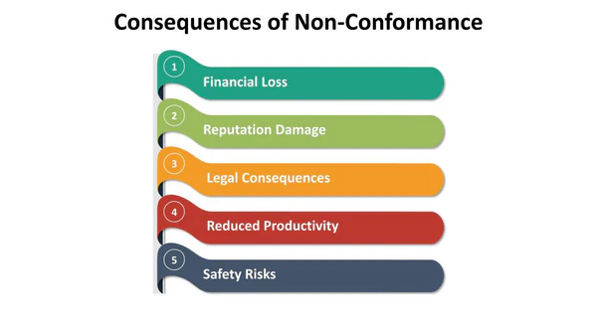
Why is it important to issue a Non-conformance Report
As part of Sinvac’s internal processes we use a NCR system to identify issues, analyse root causes and implement improvement processes to correct and prevent future re-occurrences.
If there is any deviation from any process, procedure, standard or working environment we need to raise an NCR. It is important because:
It’s critical for maintaining quality and compliance, identifying root causes, and preventing recurring issues.
It fosters continuous improvement, ensures accountability, and reduces risks in future operations, ultimately protecting Sinvac’s reputation and resources.
It build a sustainable product and process, which in the longer term increases the profitability of the business as it avoids the loss of business.

Slide 6

When to issue a Non-conformance Report
A non-conformance report is issued whenever a product, service, or process does not comply with the requirements.
The following examples can be an indication for issuing an NCR:
Product failure/ quality issues during manufacturing.
Any type of equipment malfunction.
Any raw material processing errors.
A defective product is returned to the manufacturer.
Products fails final/site inspection.
A vendor supplies incorrect components.
Products are delivered late to customers.
A deviation from any Standard Operating Procedure.

Slide 7
How to issue Non-conformances report
Raise the NCR by completing the following information
  Date of Incident
  Basic information
  Severity of incident
  Full description of Non-compliance
  Send for investigation to investigator and Madelein (For numbering of NCR)
Investigation of the following must be completed within the 1st 24 hours by the investigator
  Sub standard acts and conditions
  Immediate corrective actions
Investigation of the following must be completed within 2nd 24 hours by the investigator
  Root cause analysis
  Preventative corrective actions
Sign off
  NCRs are signed of by BU Managers
  Customer related (Returns and complaints), Credit notes, High risk and catastrophic NCRs are reviewed weekly and signed of by EXCO.
Take Note: Credit note Requisition Form will require a registered NCR number before processing will take place.

Slide 8
The NCR
Sinvac has now automated the process.
Start the process here: https://forms.office.com/r/fX9jMzJ6t4

